Slide 1


Slide 2

C PROJECT
WORKSHOP

Slide 3


Why C?
01
Portability
02
Understand the machine
03
Memory Manipulation

Slide 4
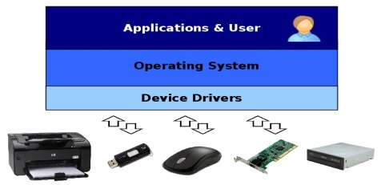

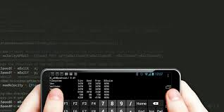

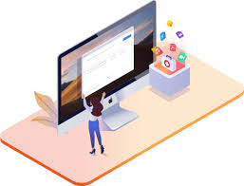
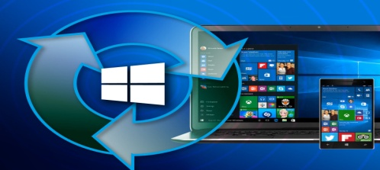
How is the world powered by C
Device Drivers
Databases
Device drivers are also coded in C.
World’s most popular databases, including Oracle ,SQLite , MySQL are coded in C .
Mobile
IOS, Android and Windows Phone kernels are also written in C.
Linux & Mac
Linux is also written mostly in C.
Mac computers are also powered by C, since the OS X kernel is written mostly in C
Microsoft Windows
Microsoft’s Windows Kernel is developed mostly in C

Slide 5
What Is This Workshop All About?
An SCA Initiative
STUDENTS LOVE OUR INITIATIVE AND IT’S RATING IS 4.6 STAR.
STARTED IN JULY 2017
WE HAVE DONE 5 PROJECTS AND THIS IS OUR SIXTH PROJECT FOR THIS BATCH
MORE THAN 3900 DEVLOPERS HAVE DONE THEIR FIIRST PROJECT WITH US
MAINLY AIMED TOWARDS IMPROVING PRACTICAL SKILLS OF OUR STUDENTS

Slide 6
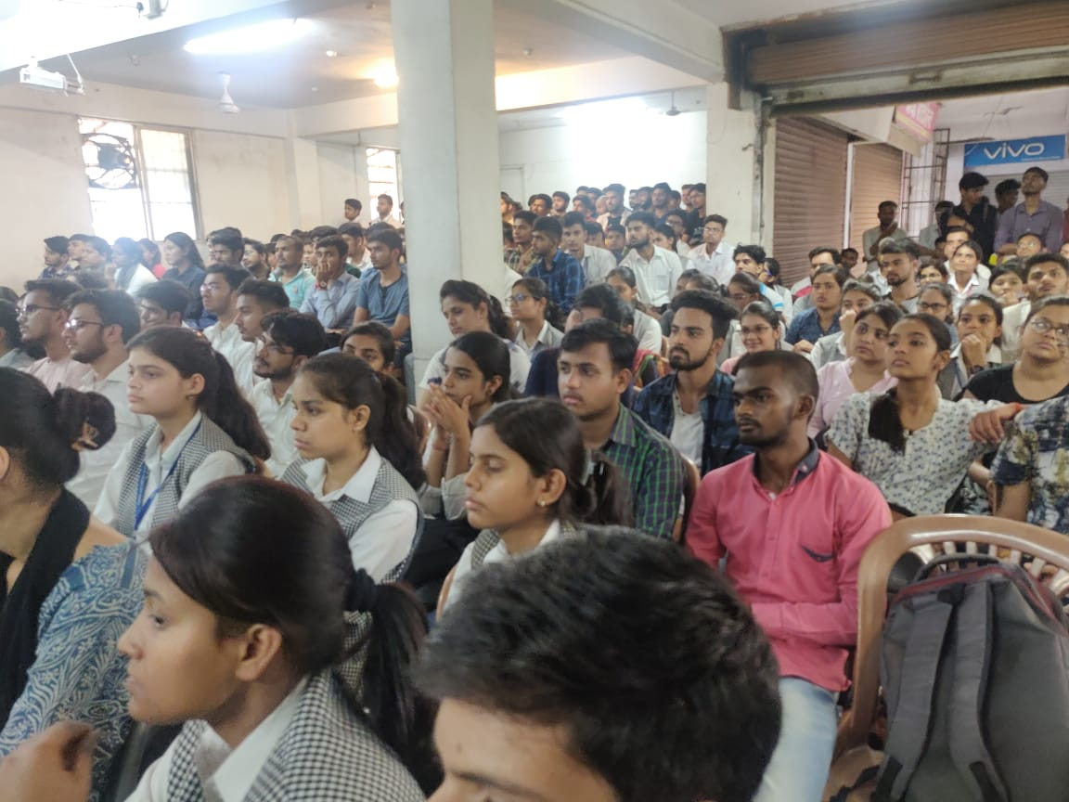
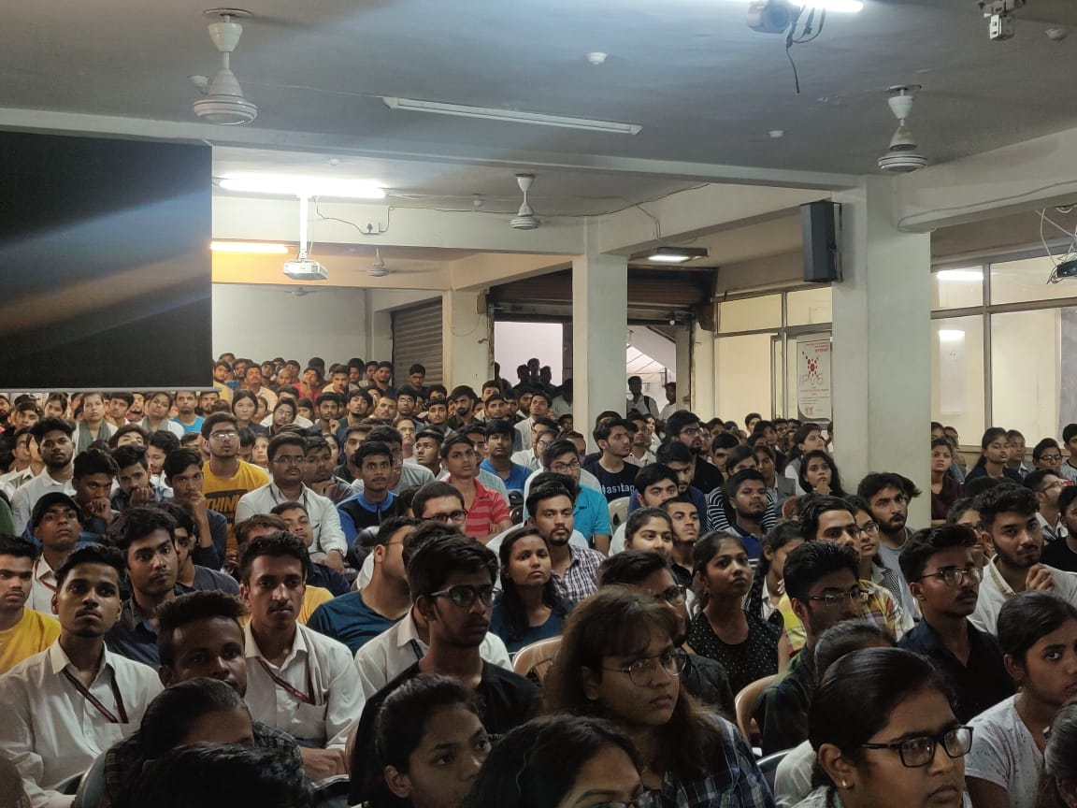
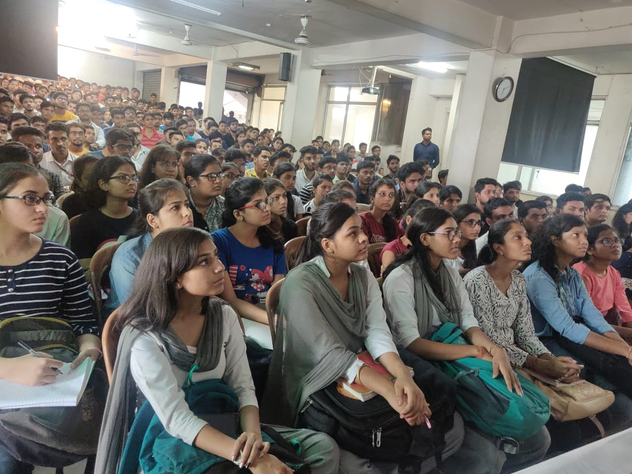
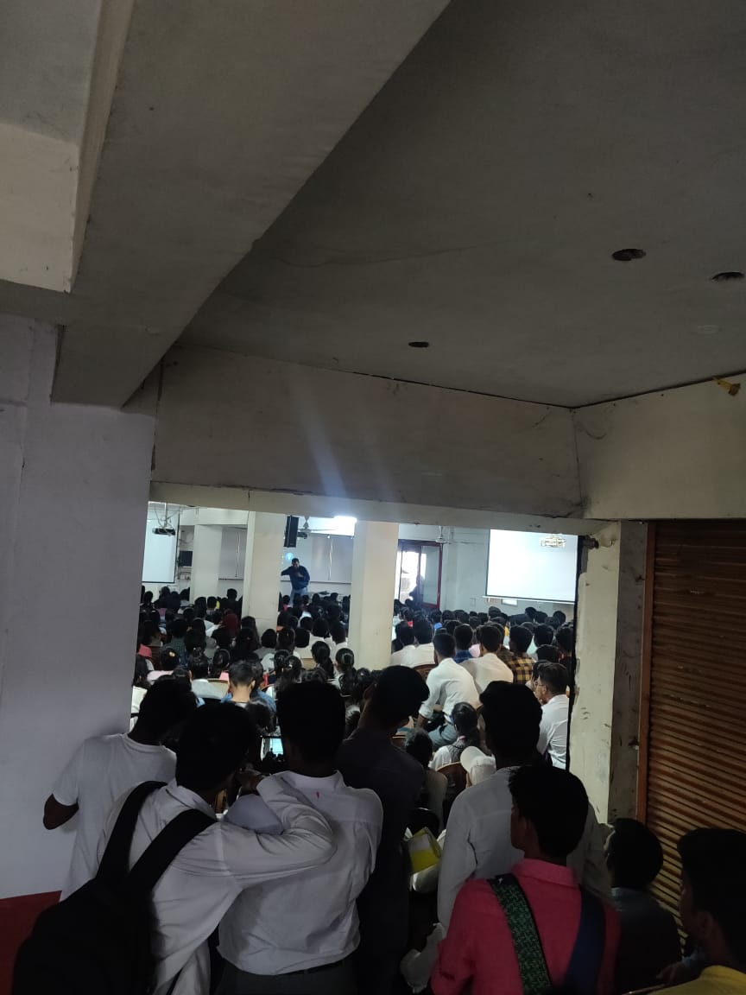
Our Project Batch Snapshots

Slide 7
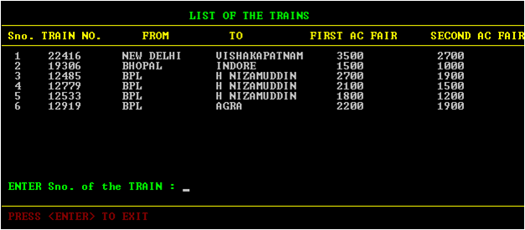
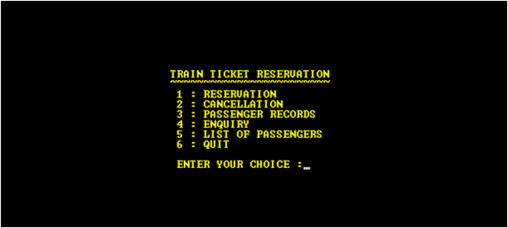
Our Projects
Railway Reservation System

Slide 8
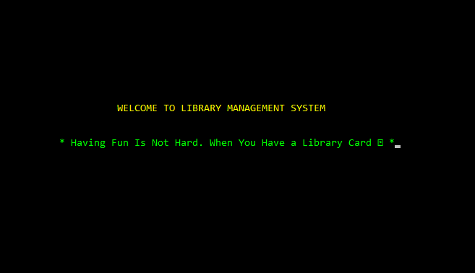
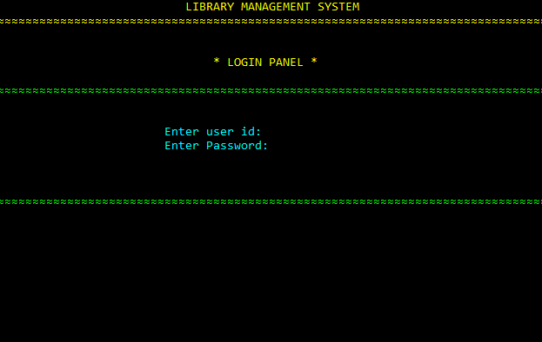
Our Projects
Library Management System

Slide 9
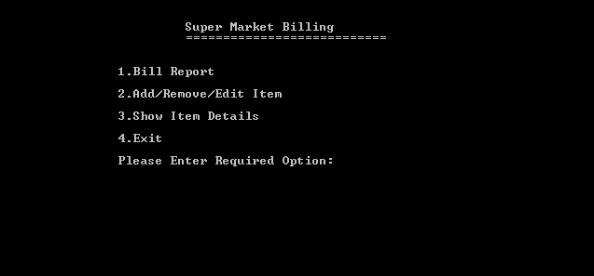
Our Projects
Super Market Billing

Slide 10
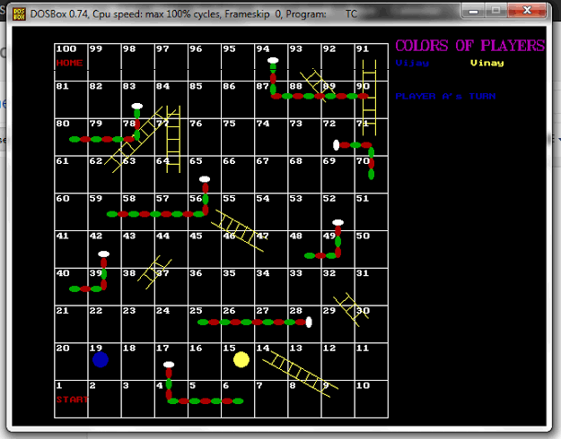
Our Projects
Snakes and Ladders

Slide 11
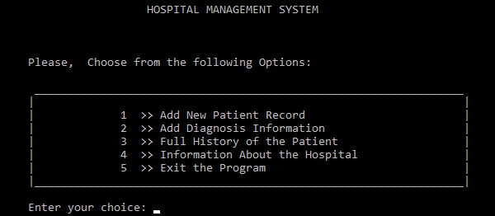
Our Projects
Hospital Management System

Slide 12

Key highlights
Develop
a Project
Learn Industry Standard
On the Spot Practical
Assignment
Certificate
Free

Slide 13
Pre Requisites
Students should have basic experience on at least 1 IDE.
Students should have adequate knowledge of basic C topics like Arrays, Functions, Pointers and Structure.
Students need to bring their laptop with CODEBLOCKS v-16 or above.

Slide 14

What We will Learn?
Migrating To Code Blocks

Slide 15
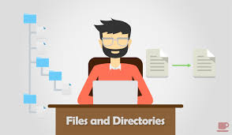
What We will Learn?
File Handling

Slide 16
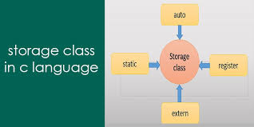





Alternative resources
Storage Classes

Slide 17
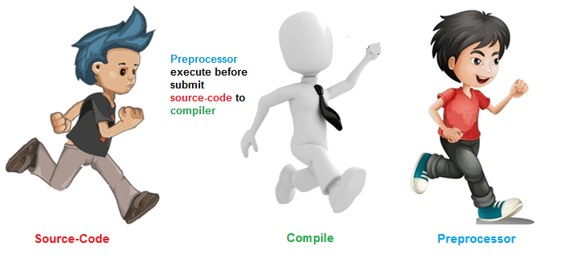
What We will Learn?
Preprocessor Directives

Slide 18
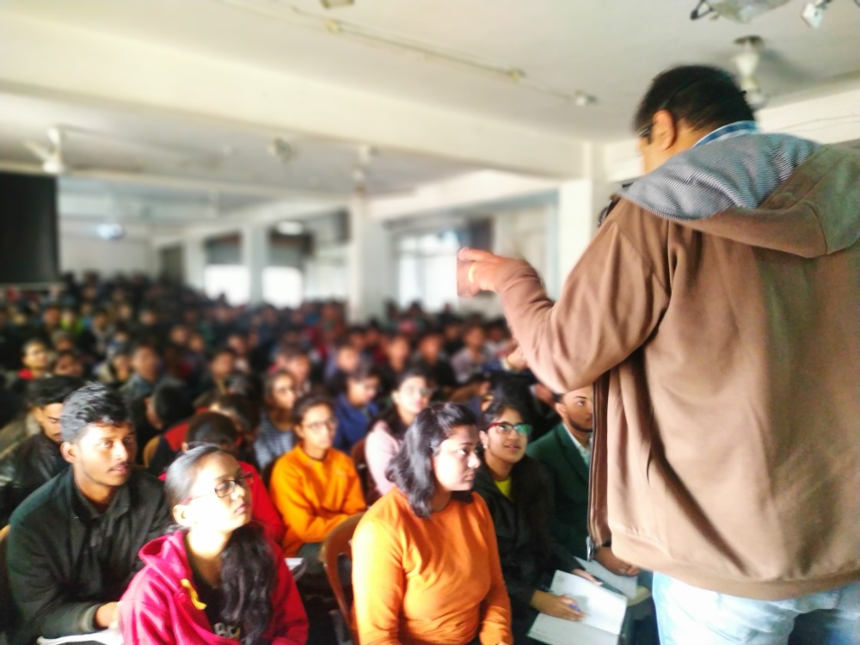
Ready for Project
START

Slide 19
Alternative resources
Movie Ticket Booking is a project in C, built as a console application. It demonstrates the use of file handling and other advance concepts of C language .
The purpose of the project is to build an application which can reduce the manual work of managing the bookings of movie.
It uses menus for migrating from one screen to another. Also, for all CRUD operations , separate functions are used.

Slide 20
Modules in the project
ADMIN
USER

Slide 21
Admin Module
Delete
Theater
Add Movie
Details
Add Theater
Show Theater
Add Movie
Details
Show Movie
Details
Change as well as
View profile
Delete Movie
Details

Slide 22
User Module
Delete Account
Change as well as view profile
Book Ticket
View Booking
Show Movie
Cancel Booking

Slide 23
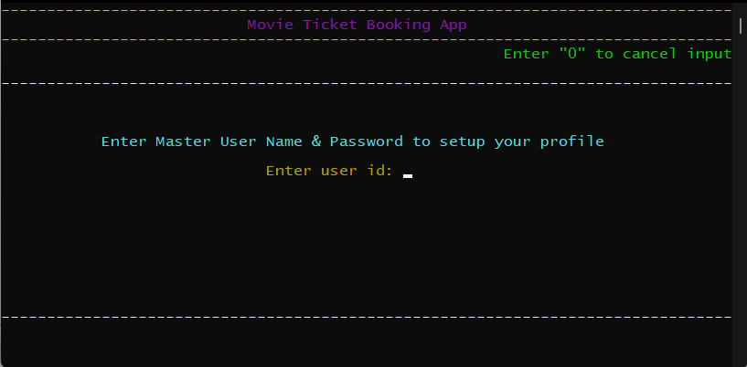
Project Screenshots

Slide 24
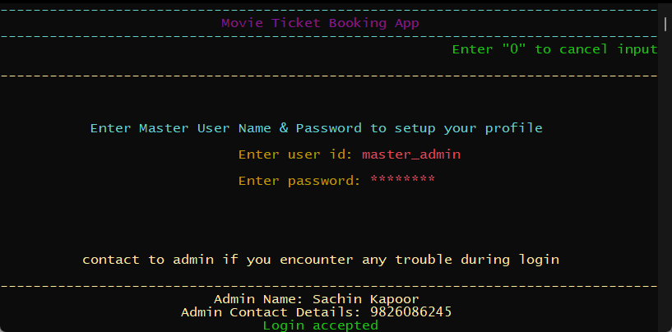
Project Screenshots

Slide 25
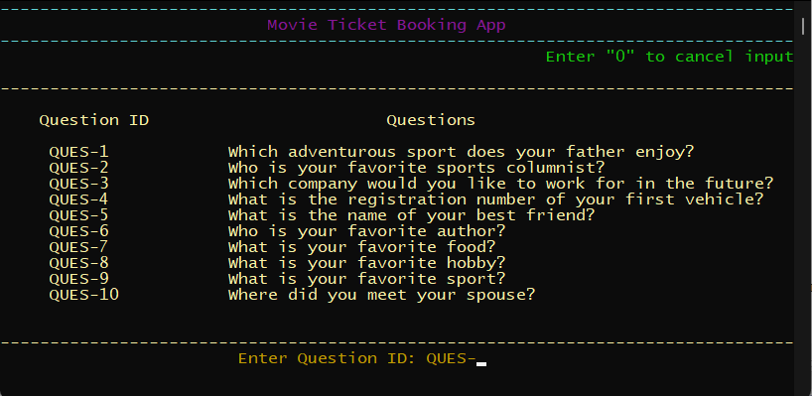
Project Screenshots

Slide 26
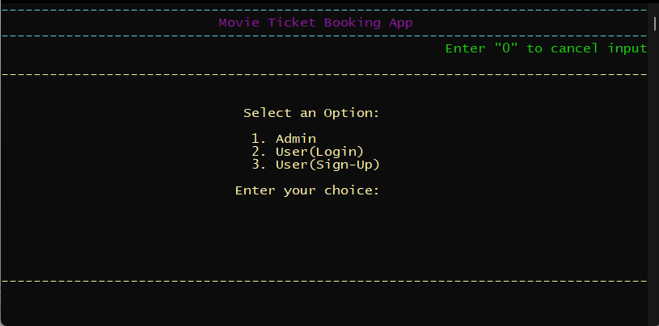
Project Screenshots

Slide 27
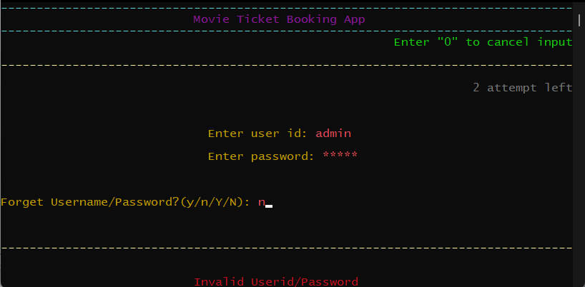
Project Screenshots

Slide 28
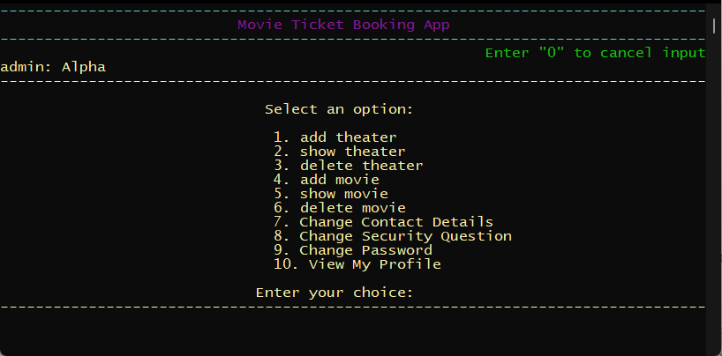
Project Screenshots

Slide 29
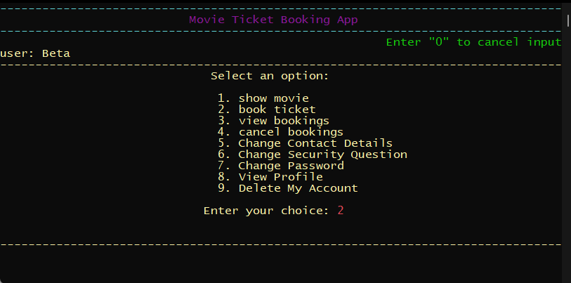
Project Screenshots

Slide 30
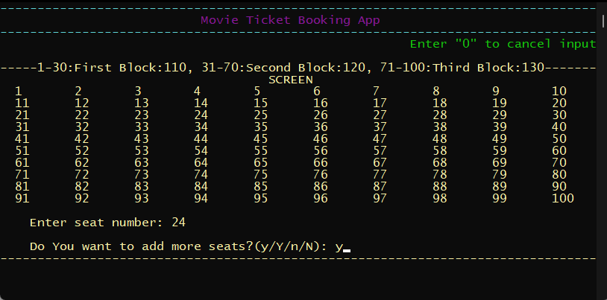
Project Screenshots

Slide 31
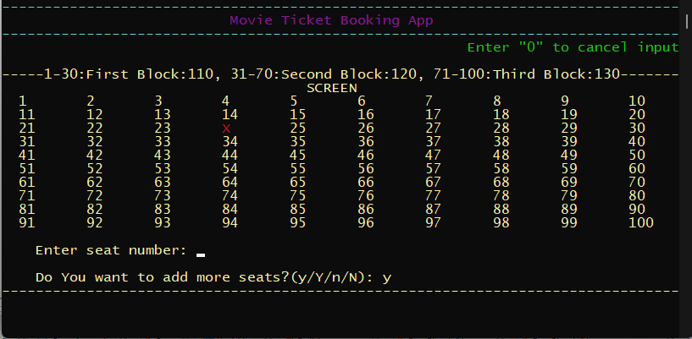
Project Screenshots

Slide 32
First Class Schedule
Date | Time | Topic Covered | Faculty
17-Apr-2022 | 12:30 P.M. | Migration to CodeBlocks | Sachin Sir and Team

Slide 33
Batch Days
Day | Time
Saturday | 9:45 P.M.
Sunday | 12:30 P.M.

Slide 34
Project Complete Condition
100% Attendance.
Satisfactory Project Performance.
Timely Completion Of Assignments

Slide 35
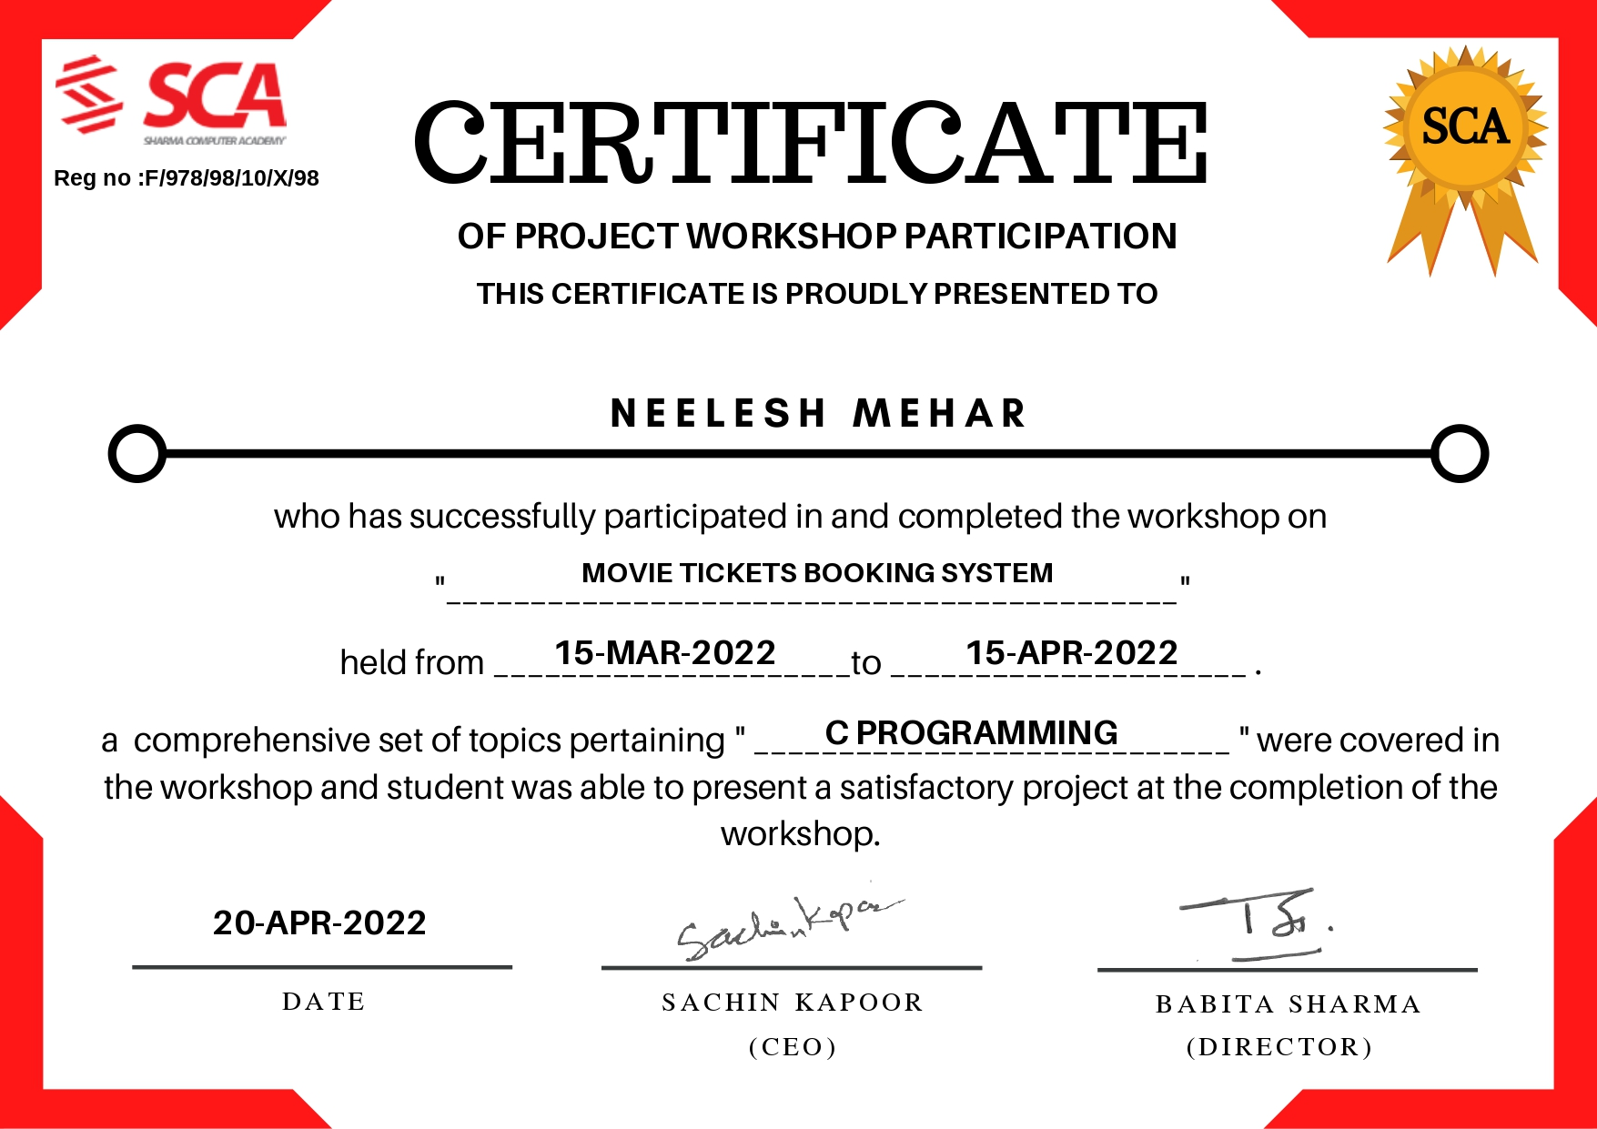
Certificate

Slide 36


Slide 37


